Slide 1
PIMMS updates

Slide 3
File importing
Peak
alignment
Blank
subtraction
Branching
filter
Smearing
filter
KMD, CF₂ homologous
series filtering
Smearing
filter
ML CCS v m/z
filter
Reference mass filter
Feature | m/z | CCS | RT | Formula matching? | Kaufman matching?
Kaufman plot integration
External library matching
Isotopic
modeling
Working in v1.2
Working in v1.1 – needs to be added to v1.2
New

Slide 4
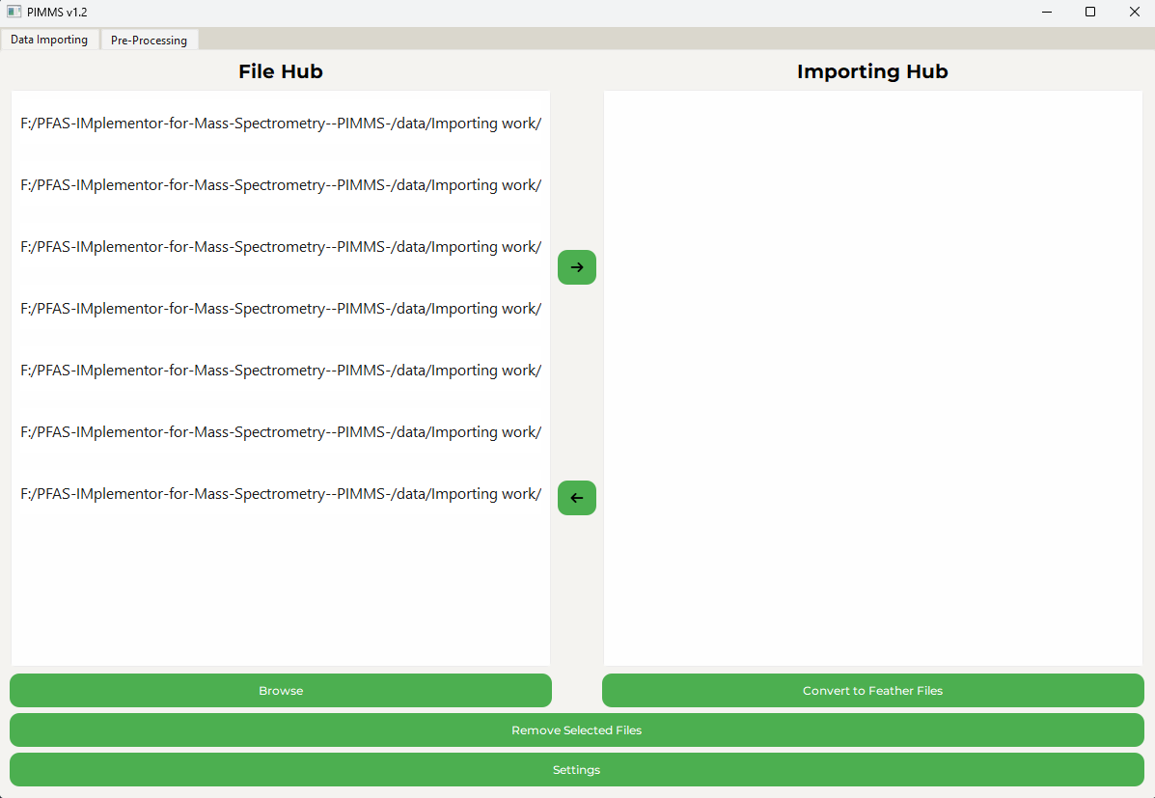
Building out PIMMS v1.2
V1.1 has been used successfully with aims to be included in 2 publications at least by the end of the year
Goal is to make V1.2 into a distributable application

Slide 5
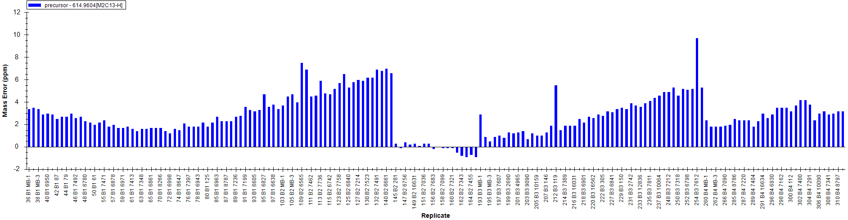
What does it mean to be the same as something else?
100, 100.001
If you set a tolerance of 0.005 – these are the same
(100.001-100<0.005)
100.000, 100.001, 100.002, 100.003, 100.004, 100.005, 100.006
Complexity of calculation grows exponentially as each value must be compared to each other (n² calculation)
100.006 would typically be classed with 100.000 by a technician knowing that there is some degree of instrument “drift” across a run which is acceptable
If a hard cap is set – features are lost

Slide 6

Peak alignment algorithm
CCS – typically 2%
m/z – typically 0.001%
Cluster 1
RT – typically 1 minute
Isolated point
All user defined parameters depending on the performance of the instrument
Uses DBSCAN – to my knowledge this is the first application to MS of this algorithm – exceptionally fast

Slide 7
Something potentially novel? Maybe
9ppm
Within margin of error
81ppm- points still classed as being in the same “cluster”
m/z
Results in anomalously large clusters – features which aren’t related are grouped together due to this drifting effect
However, instrument performance is known to gradually change with time – it rarely remains within the tolerance for the entire run requiring manual intervention (tuning, recalibration)

Slide 8
Drift tolerance
Points defined as noise now
Median value calculated
Drift tolerance
(user defined integer * maximum point to point tolerance)
m/z

Slide 9
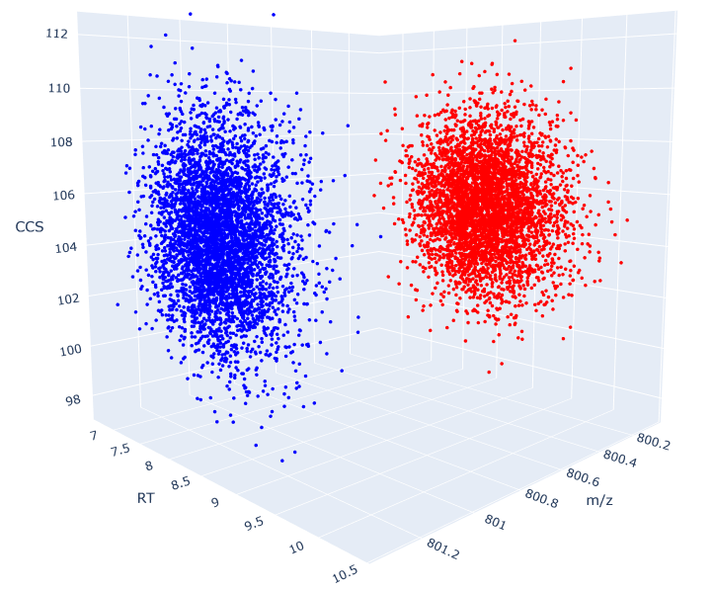
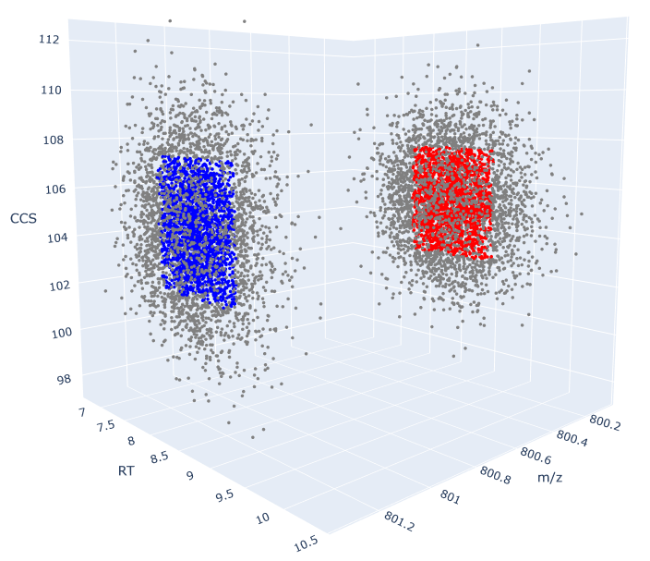
In action
1.2 drift tolerance
12.7% min-max spread
4.6% min-max spread
Totally user defined based on instrument performance
Good for things like SLIMS with known drift due to long path lengths

Slide 10
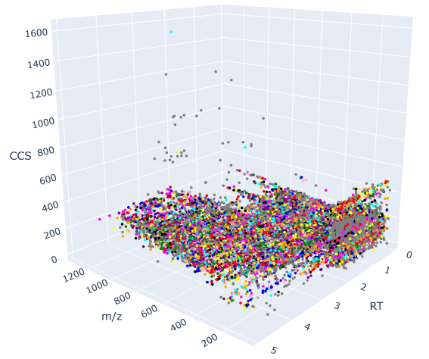
Operating with experimental data
Visualizing clusters – processes files in a comparable time to Agilent’s mass profiler despite being more advanced
Processing >30000 rows of data from 4 experimental files to produce >8000 clusters in 20 seconds

Slide 11

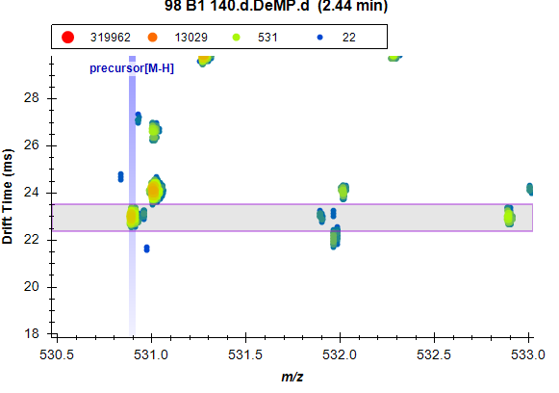
Isotopic modelling
Isotopic fingerprints

Slide 12
Isotopic modelling
Experimental Data
C₈F₁₆O₄SCl – isotopic distribution model
The matching gives us confidence that chlorine must be present, aiding greatly the identification of an unknown feature
Relies on a TON of trial and error – you need to know what exactly you’re looking for and there are often 100s of valid combinations of elements within a compound

Slide 13
Experimental isotopic distribution
Library match
Does the matching to an external library make sense with it’s library match
Increased confidence in IDs
C_{x}H_{y}F_{z}O….
For the monoisotopic mass 530.89504 (9Cl – PF3ONS M-H) there are >1000 formulas that match within a 10 ppm tolerance
Identifying the presence of only one Cl, S reduces that list to 81
Eliminating the presence of P reduces the list further to 6

Slide 14
Does the matching to an external library make sense with it’s library match?
Automated comparison of the formula match with the theoretical distribution
Software can perform a similar operation in fragmentation matching – nothing exists for isotopic modeling
isotopic distribution model
Experimental Data

Slide 15
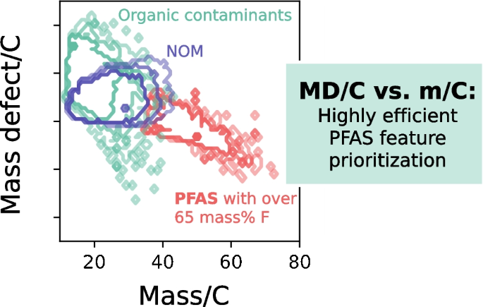
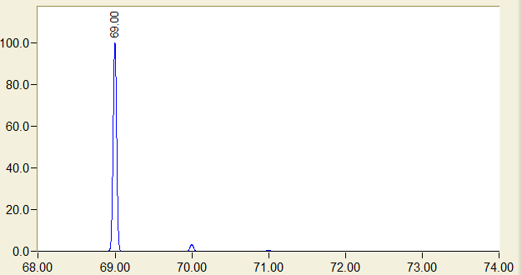
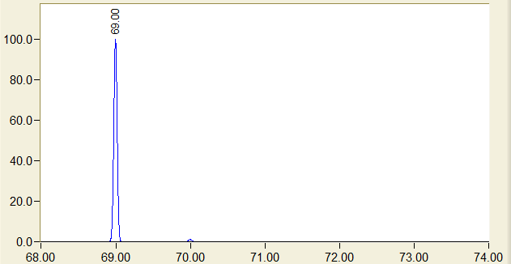
Kaufman integration
Fluorine has a unique property – a slightly negative mass defect (slightly below the integer)
Also unique in abnormally low abundance in M+1 peak giving a distinctive isotopic distribution
C₃HO₂
68.9977
CF₃
66.9952 Da
Zweigle, J., Bugsel, B. & Zwiener, C. Efficient PFAS prioritization in non-target HRMS data: systematic evaluation of the novel MD/C-m/C approach. Anal Bioanal Chem 415, 1791–1801 (2023). https://doi.org/10.1007/s00216-023-04601-1

Slide 16
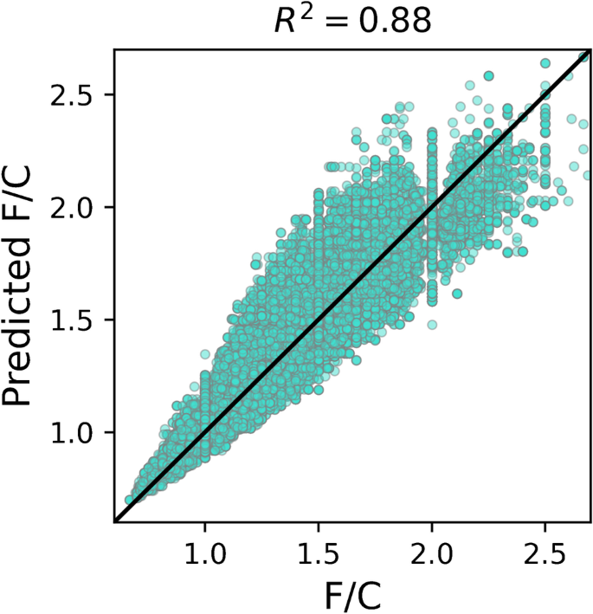
An idea
Can be used to predict the ratio of Fluorine to Carbon present in a molecule with decent accuracy across 52,769 PFAS
This can be used to further advise the isotopic distribution matching – does the candidate structure match the predicted ratio of fluorine to carbon?
This functionality would be novel – there currently is no application that automates kaufman analysis, or uses that in molecular matching
Zweigle, J., Bugsel, B. & Zwiener, C. Efficient PFAS prioritization in non-target HRMS data: systematic evaluation of the novel MD/C-m/C approach. Anal Bioanal Chem 415, 1791–1801 (2023). https://doi.org/10.1007/s00216-023-04601-1

Slide 17
Work produced using PIMMS v1.1
Novel PFAS discovered in alligator serum in the Cape Fear River in NC.

Slide 18
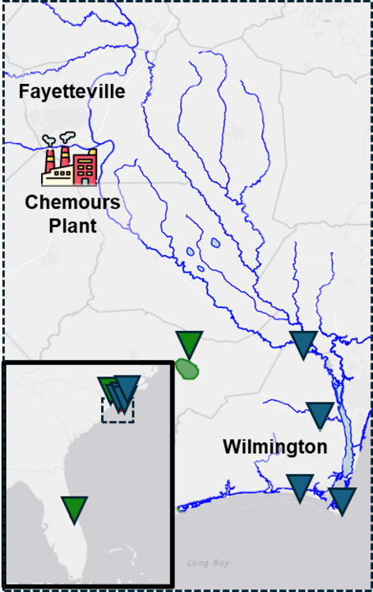
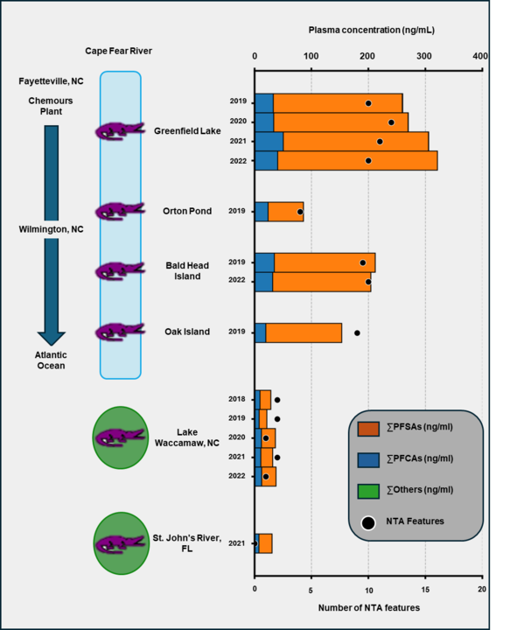
On average detecting 5-15 features that would be completely missed otherwise

Slide 19
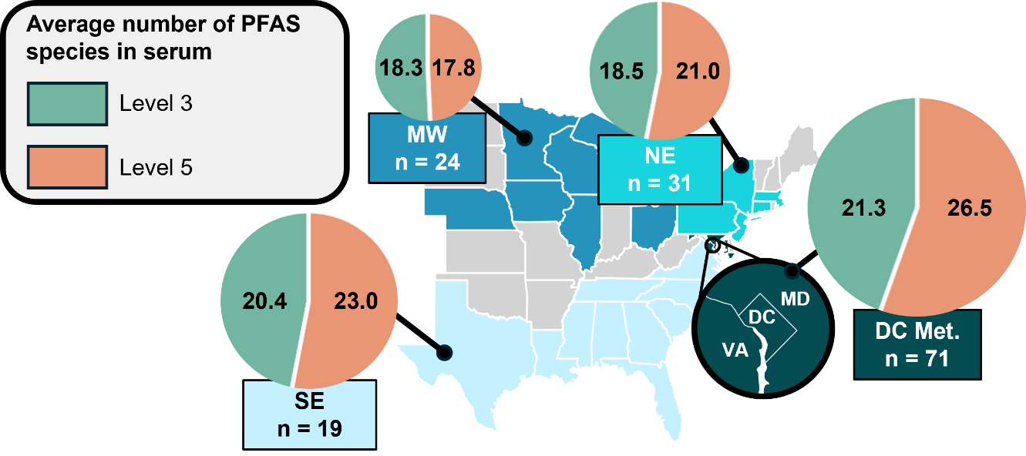
More than would be identified by a strict targeted analysis
An average of 26.5 features that would otherwise be missed
Figure 1 Locational trends of Level 3 and Level 5 confidence-level PFAS annotations. Pie charts are scaled to reflect the total number of detections and display the relative distribution of average detections of Level 3 and Level 5 PFAS found in individuals from each geographic region. The Washington DC Metropolitan region (DC Met.), Southeast (SE), Northeast (NE) and Midwest (MW) regions are displayed. States depicted in gray had no participant enrollment.

Slide 20
What do we do with this?
It’s a lot of useful algorithms which are being joined into a single application
Smearing filter, ML CCS v m/z filter, isotopic distribution analysis, and drift tolerance (to my knowledge) are novel
The peak alignment, kaufman analysis, Kendrick mass defect, CF₂ homologous series analysis are all other people’s algorithms slightly modified to work with PIMMS
It’s produced some interesting data MUCH faster than the alternative (months -> days)
We’re getting in interest in distributing to collaborators at other institutions

